Slide 1
Beaufort wind scale evidence

Slide 2
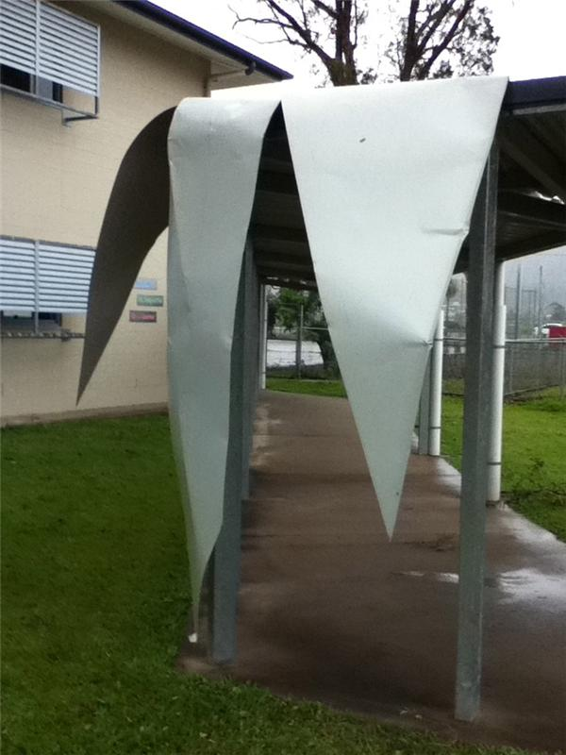
Roofing hangs off a walkway at Hambledon State School after Severe Tropical Cyclone Yasi.
Image courtesy of: Kathleen Maccoll. Used with permission.

Slide 3
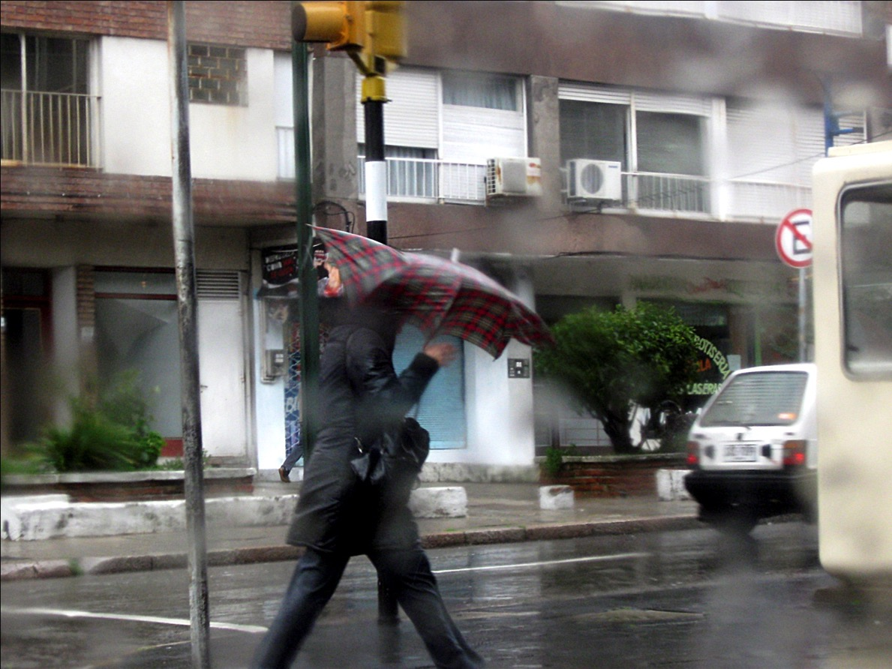
http://www.morguefile.com/archive/display/704365

Slide 4
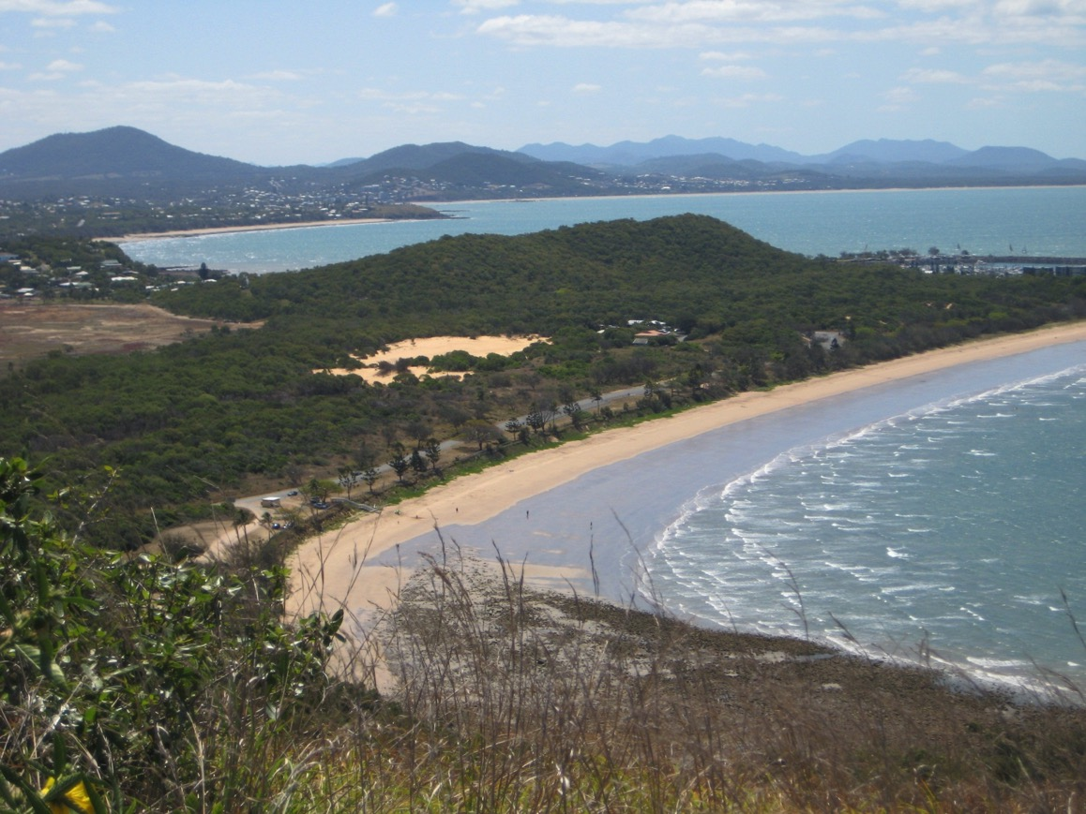
Image courtesy of: Vivienne Alexander. Used with permission.

Slide 5
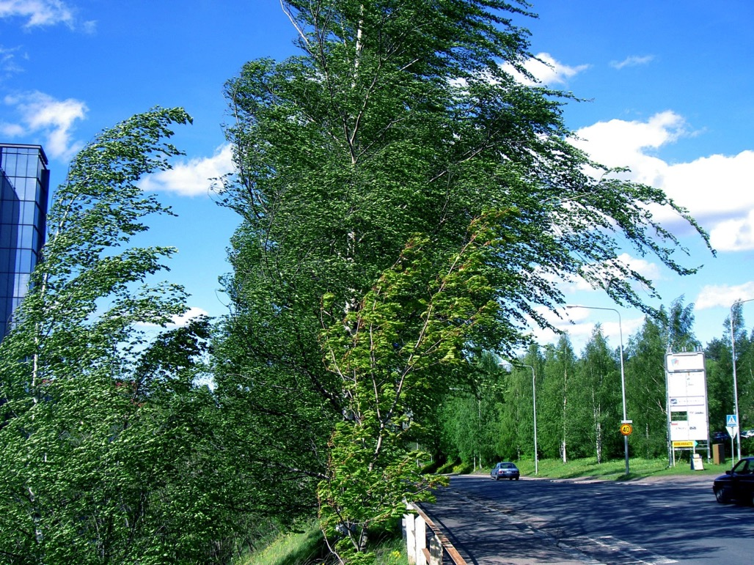
Trees bending in the wind
Teemu Maki from fi CC BY-SA 3.0 https://creativecommons.org/licenses/by-sa/3.0/deed.en

Slide 6
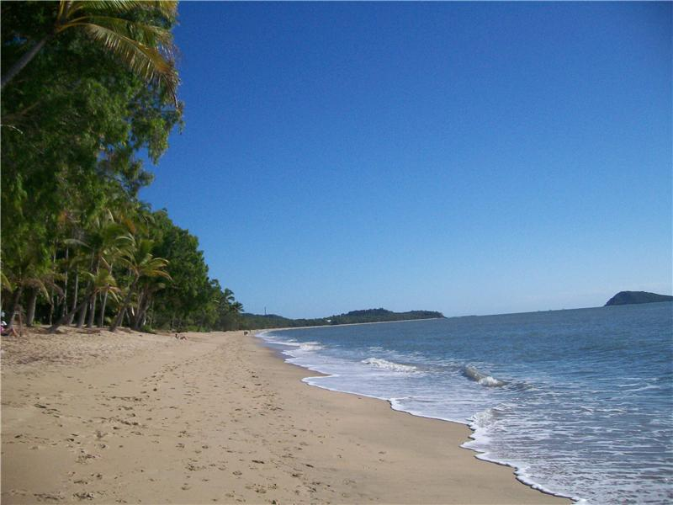
Image courtesy of: Kathleen Maccoll. Used with permission.

Slide 7
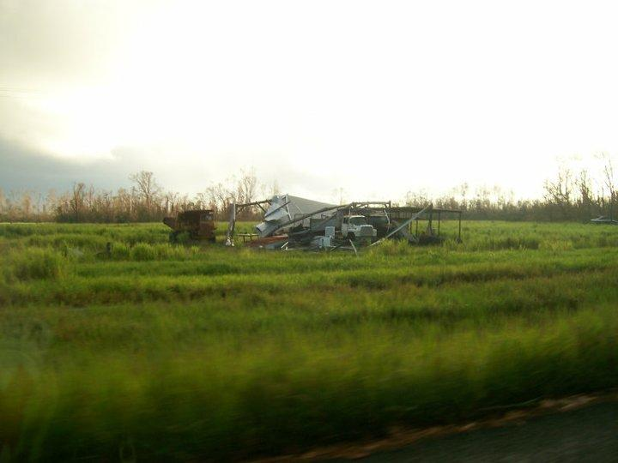
A shed destroyed by Severe Tropical Cyclone Yasi just north of Cardwell.
Image courtesy of: Kathleen Maccoll. Used with permission.

Slide 8
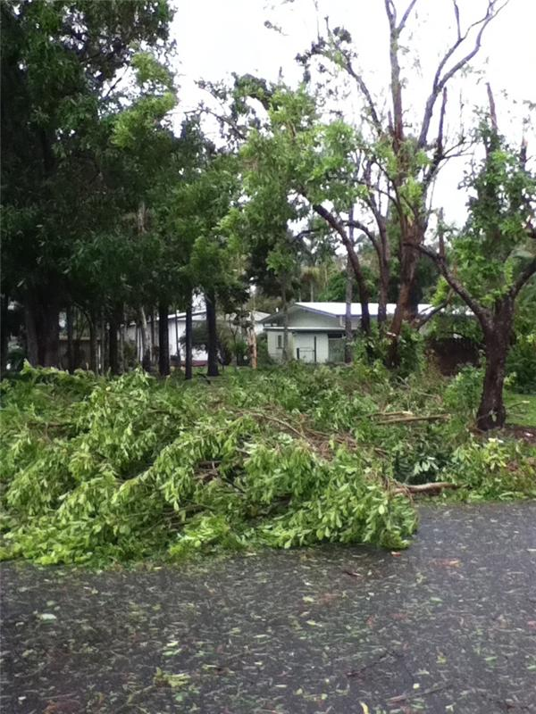
Some of the tree damage from severe Tropical Cyclone Yasi on the south side of Cairns (Edmonton).
Image courtesy of: Kathleen Maccoll. Used with permission.

Slide 9
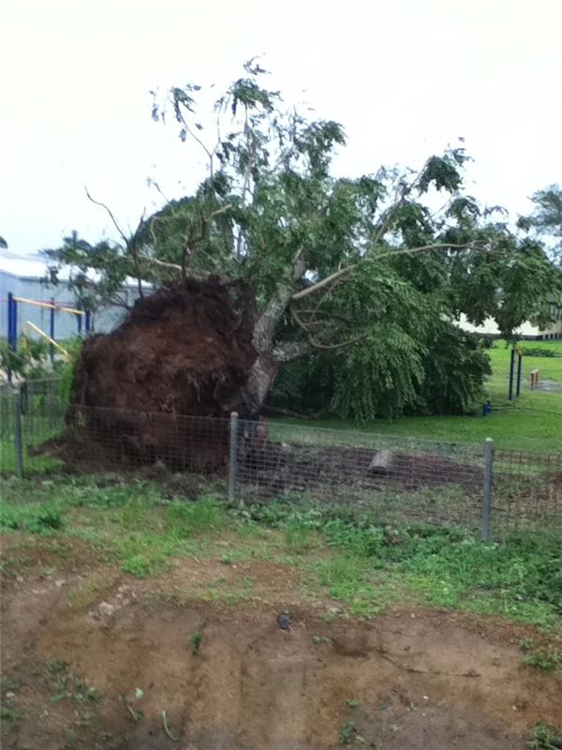
This large tree was blown down during the winds of severe Tropical Cyclone Yasi. This tree stood on the oval at Hambledon State School on the south side of Cairns.
Image courtesy of: Kathleen Maccoll. Used with permission.

Slide 10
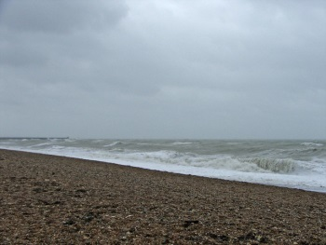
Storm-driven waves
Christine Matthews CC BY-SA 2.0 https://creativecommons.org/licenses/by-sa/2.0/deed.en

Slide 11
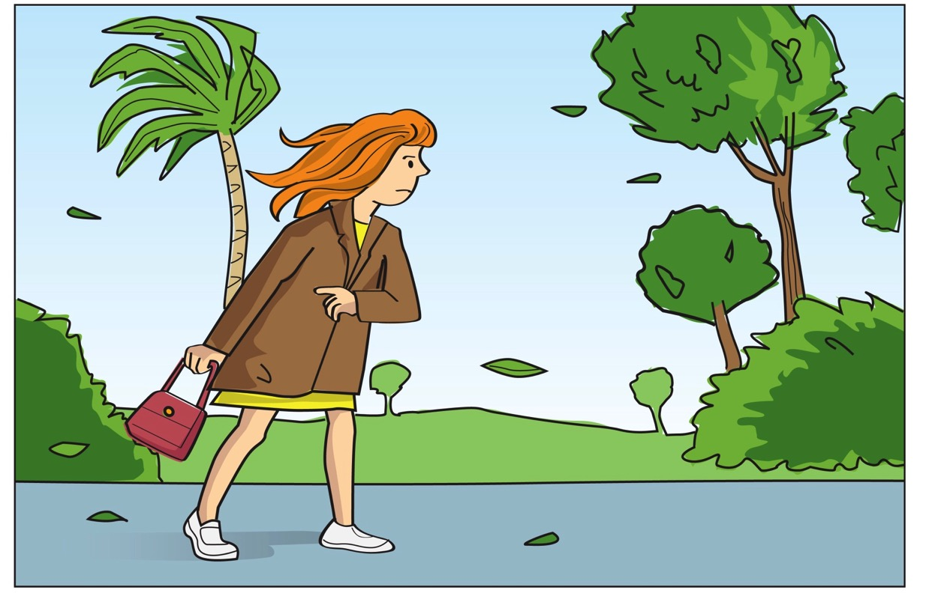

Slide 12
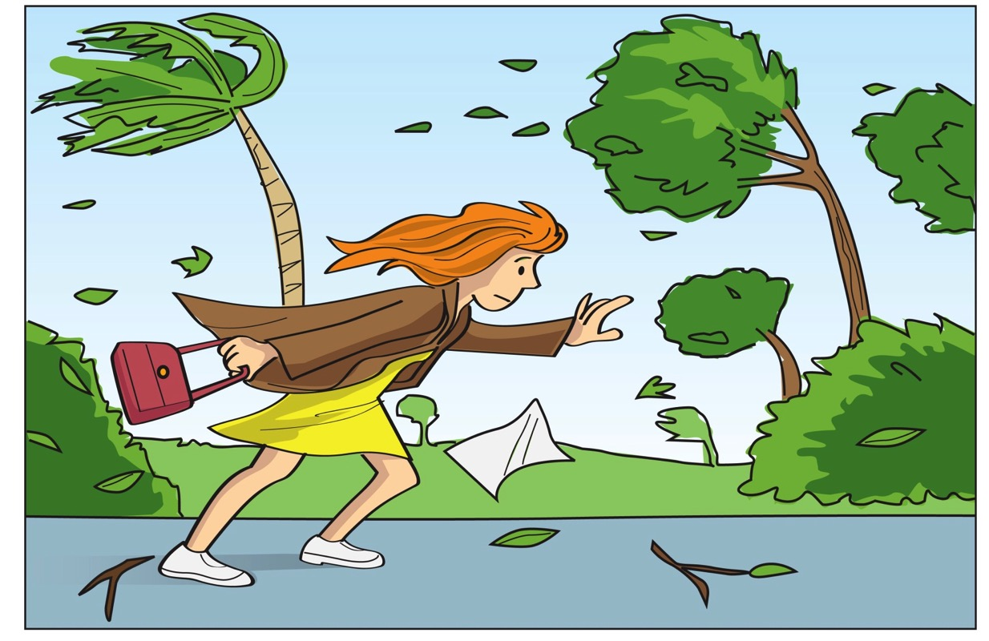

Slide 13
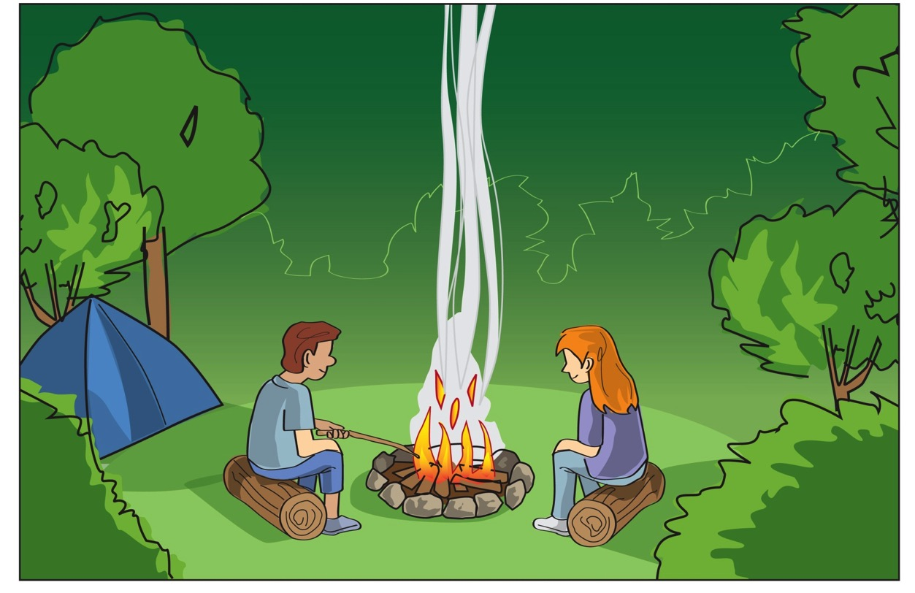

Slide 14
Emergency services are on their way to a remote part of Queensland that was hit by a weather event.
The only information they have is a wind speed of 85 km/h which was recorded by a remote weather station.
What damage can they expect to find?

